Slide 1
Implementation Object Linking and Embedding for Processes Control Unified Architecture Specification on Secure Device
The future standard for communication and information modeling in automation
Yuankui Wang

Slide 2
Agenda
Introduction and Motivation
OPC Unified Architecture Specification
Smart Card Technology
Implementation Scenario
Goals
Time Lines
Reference

Slide 3
Introduction and Motivation
In industry automation world, Machine-to-Machine technology is widely applied.
Exchange gather information during collaborative machining process
motion control in legacy networks
Over 22,000 products supplied by over 3,200 vendors
Crucial: system interconnectivity, common interface for communication, security
Classic OPC offers solutions for data access, historical data access, alarms and events.
But there exits limitations and imperfections
Windows platform only, DCOM/COM, no complex data structure

Slide 4
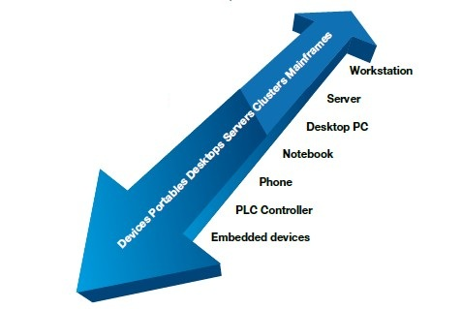
OPC Unified Architecture Specification
Platform independent data communication
Standardized communication via internet and firewalls
Protection against unauthorized access
Availability and reliability
SOA architecture
Object oriented meta model
Simplification by unification

Slide 5
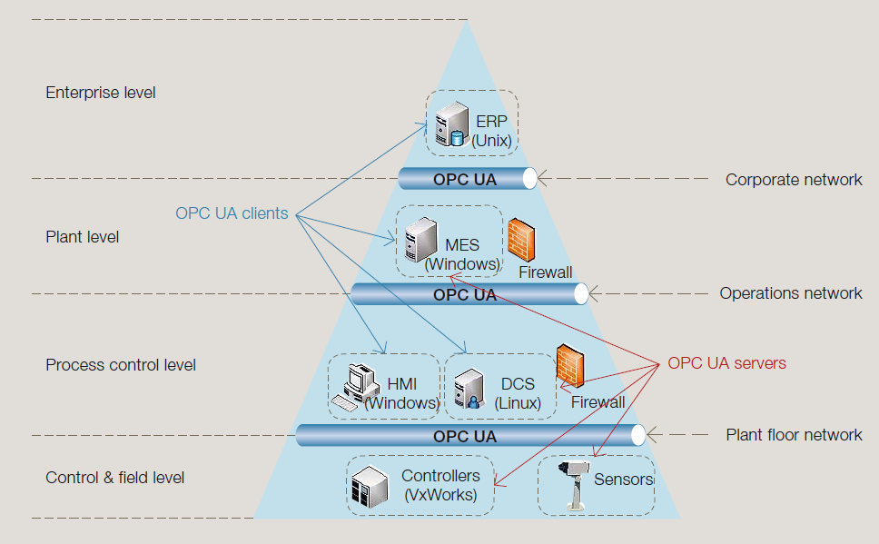
OPC UA Specification

Slide 6
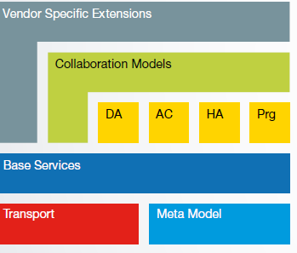
Key components of Unified Architecture
Object oriented modeling capabilities
Transport protocol bindings
Fix set of base services
OPC information model
Extendable

Slide 7
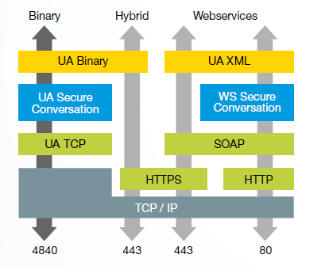
Protocol Binding
Native UA Binary(mandatory)
Extremely fast and optimized
Preferred protocol between embedded devices
HTTPS with UA Binary
Implemented low end,midrange
UA binary content in Https Msg
Using TLS encrypted transport
security

Slide 8
Protocol Binding
HTTPS with SOAP and XML Encoding
Hybrid for web client application
Or in cases only port 443 can be used
HTTP with SOAP and WS secure Conversation and
XML Encoding
High level system
Only permitted to communicate
on port 80

Slide 9
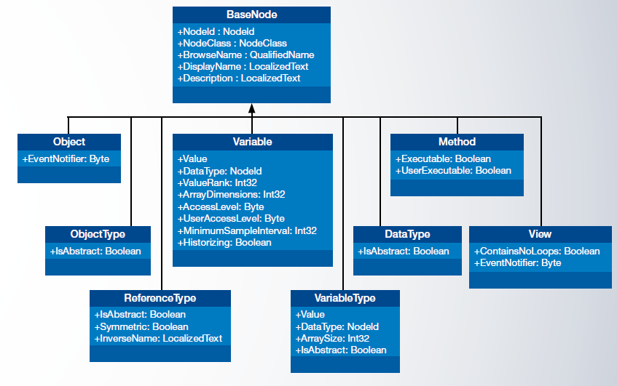
Data Model
OPC UA defines a generic object model including the corresponding type system
Generic date model
Modeling rules how physical sys can be transformed in an UA conformant model
Based on Data Model, information model is developed
Enhance the basic set of model
Data access
Alarms
Conditions
Historical Access
Programs

Slide 10
Data Model

Slide 11
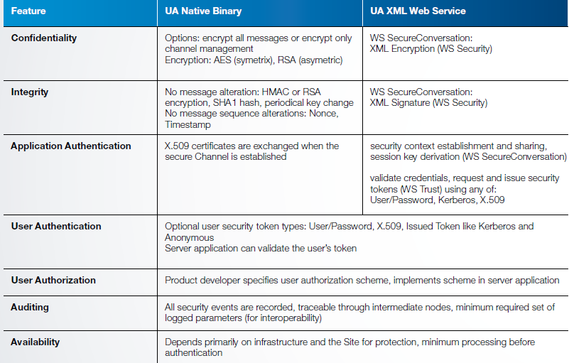
Security

Slide 12
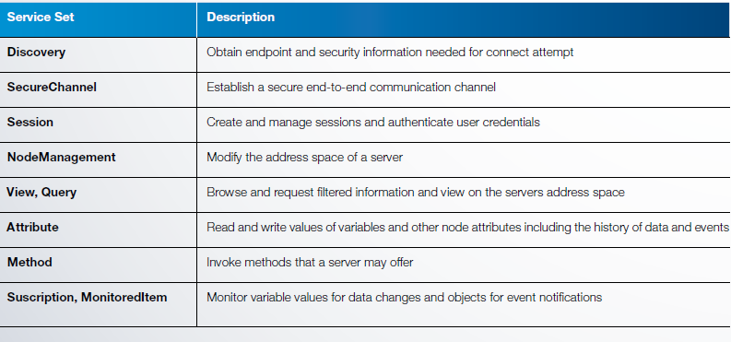
Services

Slide 13
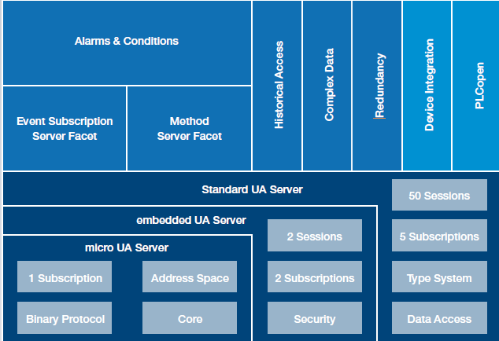
OPC UA Architecture

Slide 14
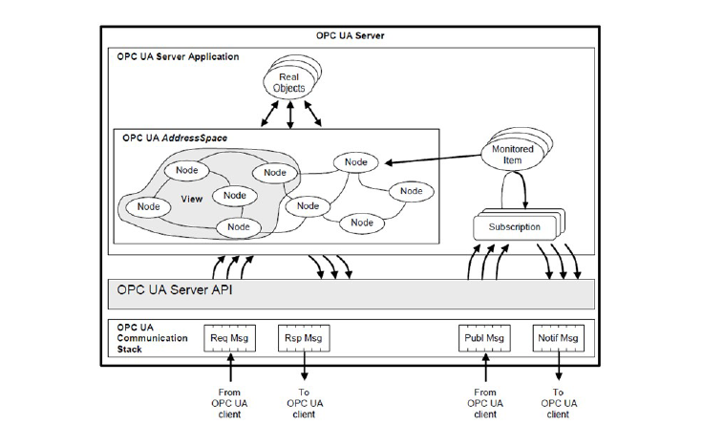
OPC UA Architecture

Slide 15
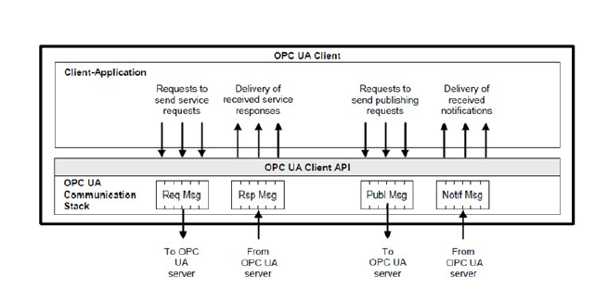
OPC UA Architecture

Slide 16

Smart Card Technology
Finance, Communication, personal identification, payment
APDU based communication between card and CAD
Security token
Process cryptographic algorithms on hardware
Self-containment structure

Slide 17
OPC UA on Secure Device

Slide 18
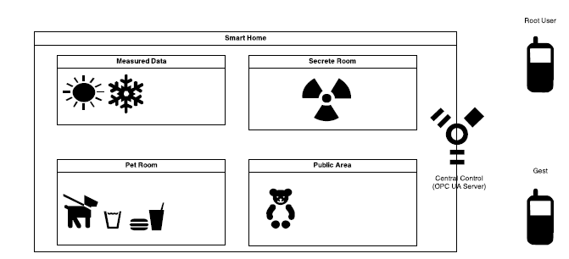
Implementation scenario

Slide 19
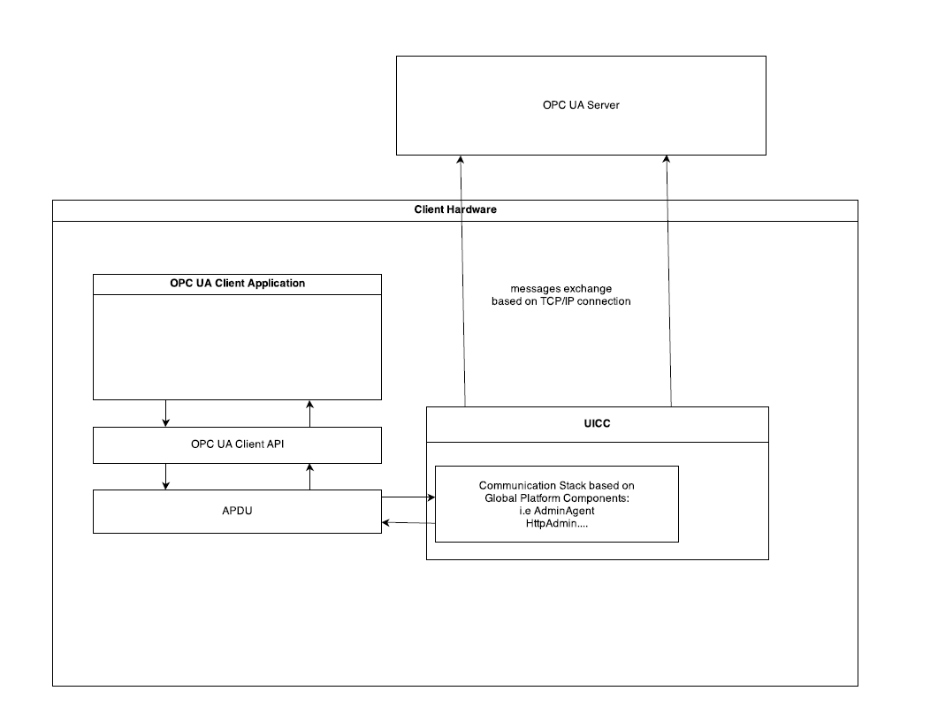
Implementation scenario

Slide 20
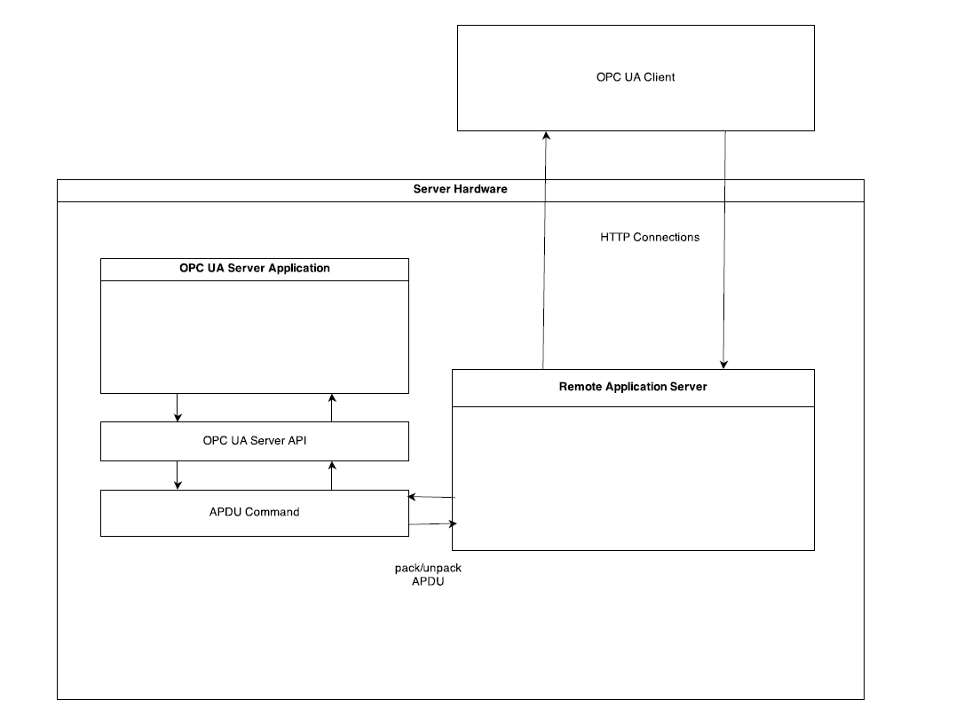
Implementation scenario

Slide 21
Goals
Describing highlighting features of OPC UA
Analyzing security protocols and their performance
Studying smart card technology
Learning security mechanisms provided by smart card
Build OPC UA standard client and server application
Build client side communication stack on smart card
Build/simulate remote application server

Slide 22
Time Lines
Reference
Dummy client/server construction
Communication stack on UICC smart card
Remote application server construction
Combination and debugging
Analyze secure protocols
Analyze performance

Slide 23
Rerferences
OPC UA specification 1-11
Stefan-Helmut Leitner and Wolfgang Mahnk: Opc ua-service-oriented architecture for industrial applications
Wolfgang Mahnke, Stefan-Helmut Leitner:OPC Unified Architecture
Wolfgang Rankl und Wolfgang Eng: Handbuch der chipkarten - 5. deutsche auflage. (2008)

Slide 24
Thank you! Question?

